Slide 1
Smart solar water heating
Domenico F. Bruscino
Senior Software Engineer @ Ditron

Slide 2

Who am I ?
    @bruscinodf
Senior Software Engineer @ Ditron
Artificial Intelligence enthusiastic
Hacking cheap connected devices
Proud father of three wonderful children

Slide 3
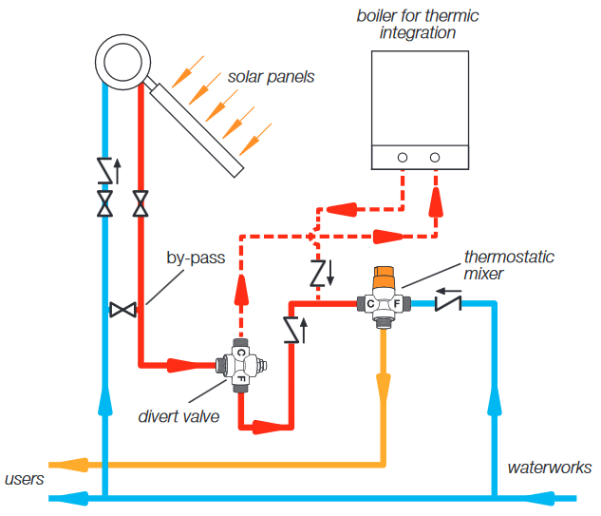
Solar water heating
Heat water using solar energy
Solar panels convert sunlights
Storage tanks keep hot water
Active vs passive systems
Two factors reduce efficiency …
  Boiler distance
  Thermal dispersion

Slide 4
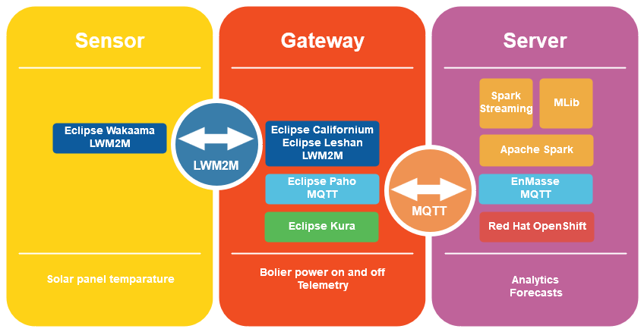
What is smart solar water heating ?
A solution using …
  … IoT technologies …
  … AI technologies …
to improve the efficiency
3rd place Open IoT Challenge 4.0!

Slide 5
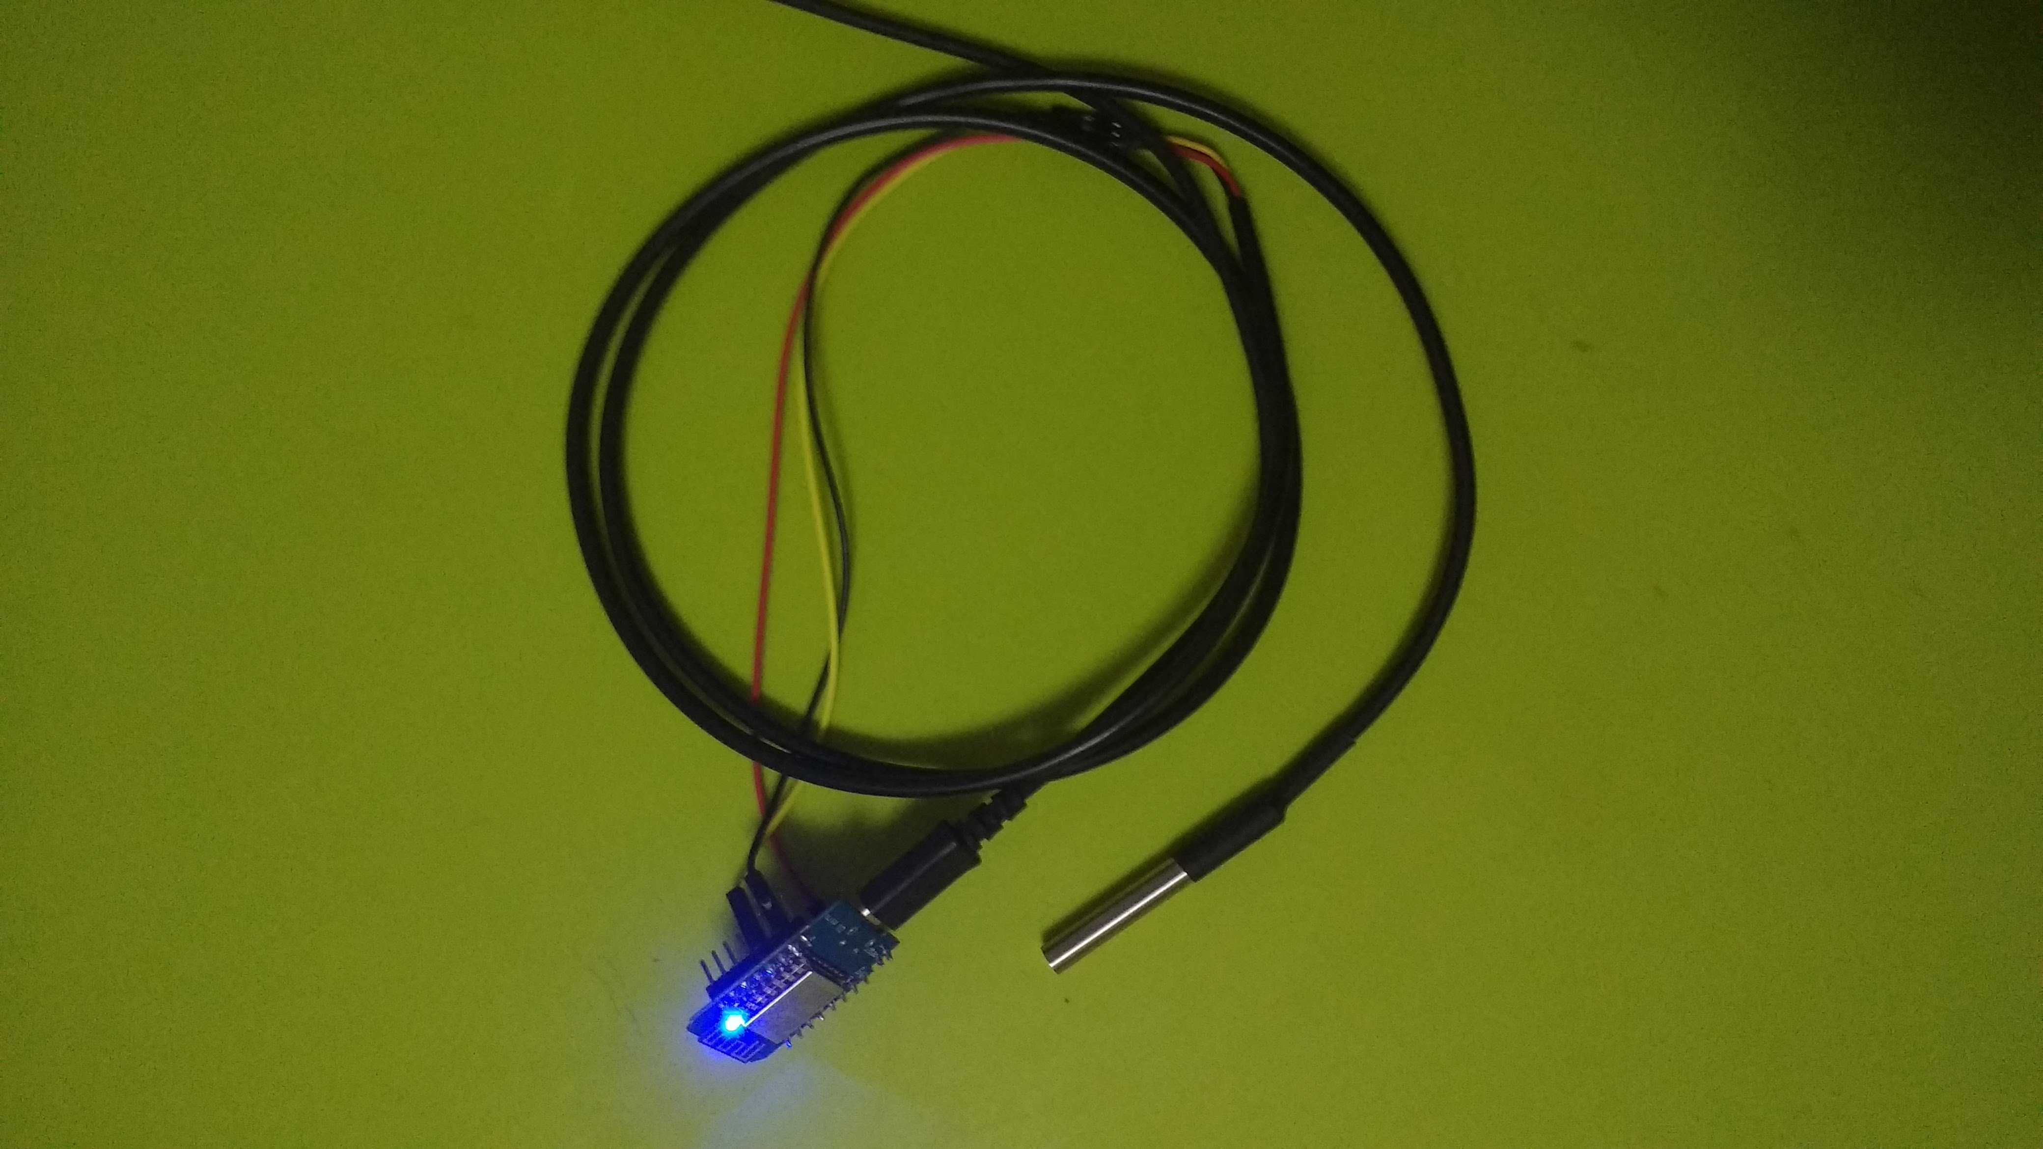
The sensor
ESP8266 board with DS18B20 probe
SDK Arduino core for ESP8266 by PlatformIO
LWM2M for communication using Eclipse Wakaama
The temperature is exposed by the object 3300 (generic sensor)

Slide 6
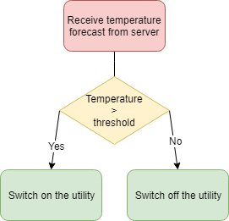
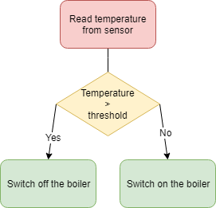
The Gateway
Raspberry Pi with a relay board
Build the IoT gateway using Eclipse Kura
Communicate with sensor (via LWM2M) using …
  Eclipse Leshan
  Eclipse Californium
Send data to server (via MQTT) using Eclipse Paho

Slide 7
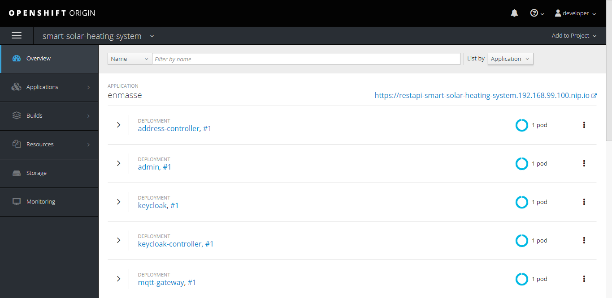
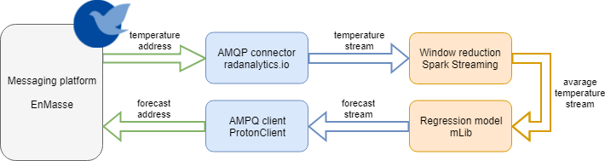
The server
OpenShift to deploy …
  EnMasse …
  Apache Spark …
Spark Streaming
mLib

Slide 8

Conslusions
This is a proof of concept.
To do …
  Allow multiple gateways
  Improve forecasts
  Add web api
  Add mobile app
Questions?

Slide 9
Resources
Smart solar heating system https://github.com/brusdev/smart-solar-heating-system
Eclipse Wakaama : https://www.eclipse.org/wakaama/
Eclipse Kura : https://www.eclipse.org/kura/
Eclipse Paho : https://www.eclipse.org/paho/
Eclipse Leshan : https://www.eclipse.org/leshan/
OpenShift Origin : https://www.openshift.org/
EnMasse : http://enmasse.io/
Apache Spark : https://spark.apache.org/

